Slide 1
七年级 （下册） 英语
重点语法 梳理

Slide 2
情态动词
定义：表示说话人对所说动作的观点，如需要，可能，意愿，等。
情态动词的特点：
1）无人称和数的变化；
2）情态动词后要加动词原形
3）否定形式- 情态动词后加not
疑问句- 情态动词提前
can
表能力 The boy can speak English well.
表示许可 You can play outside after you finish your homework.
表示请求 Can you pass me my book?
表示推测（否定）Jim can’t be in the classroom. He is playing football on the playground.

Slide 3
B
My mother __________ a new dress for the party.
need B. needs C. doesn’t needs D. don’t need
Last year, I ________ drive. I used to take the bus.
could B. couldn’t C. should D. shouldn’t
May I go out now, Dad?
No. You _________ let your mother know first.
can B. may C. need D. must
Look at that girl! Is it Lisa？
-No, it ________ be her. She has gone back to her hometown.
A. mustn’t B. can’t C. needn’t D. wouldn’t
B
D
B

Slide 4
may
表示许可，相比can而言更正式，语气更委婉 May I come in?
肯定回答：Yes, you can ; 否定回答：No, you can’t. 有时否定回答也用mustn’t.
b. 表示可能性 She may be a teacher.
maybe vs may be
could
表示过去的能力 I could climb trees at the age of six.
表示委婉的语气，用于提出请求，想法，建议 Could you tell you your name?
can VS may VS could
maybe 副词，“也许”，通常用于句首；
may be 是情态动词+be动词原形，一起构成谓语部分，通常在句中。
例句：Maybe she is our new teacher.
=She may be our new teacher.
1)我可以做什么吗？ Can I…/May I …/ Could I …
Can I have a cup of water? = Could I have a cup of water? (Could 更委婉一点）
May I…更正式，常用于服务行业 May I help you?
没有Could I help you?，could i不用于为人帮助；而相对于服务行业，日常一般用Can I help you?
2)你可以为我做什么吗？Can you…/could you (口语中没有may you，书面中常用来表示祝愿)
Could 更礼貌
Can you speak Chinese?（ 技能）/Could you speak Chinese?(在确定他会使用中文的情况下，请他使用）

Slide 5
A
5.--May I take this book out?
---No, you_____.
A. can't B. may not C. needn't D. aren’t
6.He isn't at school. I think he _____ be ill.
A. can B. shall C. must D. has to
7.The children_____ play football on the road.
A.can't B.can C.mustn't D.must
8. ---Must I do my homework at once?
---No, you_____.
A. needn't B. mustn't C. can't D. may not
C
C
A

Slide 6
must
表示“必须” We must be on time. (强调主观）
表示推测（肯定） The book must be Tom’s, it has his name on it.
have to
a. 表示“不可不；必须”
We have to be quiet in the library. (强调客观）
b. 表必须时，可与must 互换
We have to/must follow the rules.
must VS have to
区别：
强调的方向不同：must强调主观；have to强调客观；
否定含义不同：mustn’t“不准；禁止”；don’t have to “不必”；
时态不同：must只表示现在，没有人称和数的变化；
have to可用于不同的时态，且有人称和数的变化。
注意：must 的一般疑问句的回答
例如：---Must I clean the room today?
---Yes, you must./ No, you don’t have to.
或 No, you needn’t.

Slide 7
D
9.His arm is all right. He_____ go and see the doctor.
A. has not to B. don't have to C. haven't to D. doesn't have to
10.He had to give up the plan, _____ he?
A. did B. didn't C. does D. doesn’t
11. The poor man needs our help, _____ he?
A. need B. needn't C. does D. doesn’t
12. Johnny, you _______ play with the knife, you _______ hurt yourself.
A. won’t, can’t B. mustn’t, may
C. shouldn’t, must D. can’t, shouldn’t
A
D
B

Slide 8
2. 介词
表示时间的介词
at + 时刻（明确的时间点）
on+某一天的某时段或具体的某一天
in +世纪，年，月，季节，在上午/下午/晚上/白天等
其它表示时间的介词：before, after
at six o’clock
at lunchtime
at Christmas
at the age of
at noon/at night
on Sunday morning
on May 4th
on New Year’s Day
on vacation/weekends
in the 1980s 在20世纪80年代
in April
in summer
in 2022
in the afternoon/morning/eveningi

Slide 9
13.Linda watches TV _____ Saturday evening.
A.in B. on C.at D.to
14._____ November 22nd, we have an English party _____ the afternoon.
In; on B. In; in C. On; on D. On; in
15.What do you do _____ Teachers' Day?
A.on B.to C.in D.at
16.I usually watch my favorite TV program _____ seven thirty _____ Saturday evening.
A.at; in B.in; on C.at; on D.on; at
B
D
A
C

Slide 10
表示地点的介词
at + 一个点（小地点）
on+一个表面
in + 一个范围 (大地点）
前后/里外/上下 in front of/behind; inside/outside; above/under
at home
at the bus stop
at Mr. Cool’s Clothes Store
at the pool
其它表示位置关系的词：
in front of/in the front of
between…and…
in the middle of
at the back of
next to
across from
beside
near
by
along
on the table/chair
on the wall
on Center Street
on the beach
on the floor
in the sky
in Beijing/China
in the water
in the park/supermarket
in Class 5

Slide 11
D
17.—Where is the map? —It's _____ my _____ room.
A.on, parent’s B.in, parent’s C.on, parents’ D.in, parents’
18. –What do you often do ______ weekends?
-- I often go to the park ______ my father’s car.
in; by B. on; by C. on; in D. in; in
19.The lovely boy was born _______ a sunny morning _____ October, 2015.
in; in B. in; on C. on; on D. on; in
20. –Jane looks unhappy. What’s wrong?
--She can’t watch TV _______ school nights.
A. In B. at C. on D. /
C
D
C

Slide 12
3.时态 ：
在英语中，不同时间发生的动作或存在的状态要用不同的动词形式来表现
She dances every day.
She is dancing now.
She danced yesterday.
本学期学习到了三种时态：
一般现在时
现在进行时
一般过去时
复习：定义 – 标志词 – 结构

Slide 13
一般现在时 用法 | 标志词 | 结构
1.表示习惯、经常性的动作; I usually go to school by bus. 2.表示客观真理或事实； Summer comes after spring. 3.长期存在的状态； Lucy is a students. 4.能力，喜好，特征; She is a cute girl with big eyes. 5.用在以if ,as soon as, when, 等引导的条件或时间状语从句中，用一般现在时表将来 （主将从现） If it doesn't rain, we'll go to the park. 6.表示按计划或安排好的将要发生的动作，用一般现在时表示将来，但仅限于start, begin, leave, go , come, arrive等动词。 The train leaves at six tomorrow morning. Summer holidays begin next week. | 1.频度副词：always, usually, sometimes, hardly, never 2.频率词组：once a year, twice a month, three times a day等 3.其他词组：in the morning, every day/year… (every系列），on Mondays等 | 1.主语 + am/is/are 2.主语 + 动词原形/动词单三形式

Slide 14
现在进行时用法 | 标志词 | 结构
表示说话的时候正进行的动作 We are having an English lesson now. Look! The girls are dancing. It's five o'clock. Mum is cooking. 2.表示现阶段一直在做的事 I'm reading a novel these days. 3.表示不断发展变化, 动词有get，grow，turn，become The leaves are turning yellow. 4.表示将要发生的动作，只限于表示位移的动词，如：leave/ come/go/begin/ arrive/fly 等 I'm leaving for Shanghai this Sunday. Can you help me? OK! I’m coming. | 1. now, right now 2. at present, at this time, at the/this moment 3. these days 4. when, while 5. look! Listen! 等 | 主语 + am/is/are + 动词现在分词 注意: 需要双写最后一个辅音字母+ing: get –getting sit – sitting put – putting run – running begin – beginning cut – cutting swim – swimming stop – stopping drop – dropping dig – digging win - winning

Slide 15
按要求改写句子
1. The man is working on the farm.
否定句： .
一般疑问句： ？
肯定回答： .
否定回答： .
对“is working ” 提问 ？
对“ The man” 提问 ？
对“on the farm”提问 ________________________ ？
The man isn’t working on the farm
Is the man working on the farm
Yes, he is.
No, he isn’t.
What is the man doing
Who is working on the farm
Where is the man working

Slide 16
一般过去时用法 | 标志词 | 结构
1.表示过去某个时间里所发生的动作或存在的状态。 He was a student three years ago. I met my English teacher just now. 2.表示过去经常或反复发生的动作，常与频度副词连用。 When I was a child, I often played basketball in the street. The old man always carried an umbrella. | 1. ago词组 2. yesterday及yesterday词组 3. last词组 4. just now, in the past, in 1978等，in+过去的时间 5. at the age of …, used to … 6. one day, long long ago, once upon a time | 主语 + 动词过去式 规则动词: 1. 动词原形+ed （直） play→played clean→cleaned 2. 以e结尾的去e, +ed（去） live→lived dance→danced 3.重读闭音节结尾,且末尾只有一个辅 音字母的动词，双写尾字母再加ed(双） stop→stopped plan→planned 4. 辅音字母+y结尾，改y为i+ed （改） study→studied try→tried 不规则动词 不规则动词的过去式无规则可循，要注意自己积累。部分不规则动词可参考书本P141

Slide 17
Last summer vacation, I ____(take) a train to Chengdu with my family . Our trip was really great. We ____ (have) so much fun ______ (visit) the panda park. As you know ,Pandas only ____ (live) in China. In Chengdu ,there _____ (be) a very big panda park. We _________ (visit) the park and We _____(see) many pandas with our own eyes. We _____(be) so excited. They were fat and shy and they ______ (do) all kinds of actions. They ______(eat) bamboo and meat for quite a few hours. After ________(eat), they walked around the park .They were not afraid of visitors. Sometimes, they _______ (climb) on the tree and relax there. How cute they were! I took lots of photos .I also _______(buy) some pandas gifts .They were a little expensive but I liked them very much . The weather _____ (be) sunny and so hot ,but we had a good time there on that day.
took
had
visiting
live
is
visited
saw
were
did
ate
eating
climbed
bought
was

Slide 18
总结 | 定义 | 标志词 | 结构
一般现在时 | 1.表示习惯、经常性的动作; 2.表示客观真理或事实； 3.长期存在的状态； 4.能力，喜好，特征; 5.用在以if ,as soon as, when, 等引导的条件或时间状语从句中，用一般现在时表将来 （主将从现） 6.表示按计划或安排好的将要发生的动作，用一般现在时表示将来，但仅限于start, begin, leave, go , come, arrive等动词。 | 1.频度副词：always, usually, sometimes, hardly, never 2.频率词组：once a year, twice a month, three times a day等 3.其他词组：in the morning, every day/year… (every系列），on Mondays等 | 1.主语 + am/is/are 2.主语 + 动词原形/动词单三形式
现在进行时 | 1. 表示说话的时候正进行的动作 2.表示现阶段一直在做的事 3.表示不断发展变化, 动词有get，grow，turn，become 4.表示将要发生的动作，只限于表示位移的动词，如：leave/ come/go/begin/ arrive/fly 等 | 1. now, right now 2. at present, at this time, at the/this moment 3. these days 4. when, while 5. look! Listen! 等 | 主语 + am/is/are + 动词现在分词
一般过去时 | 1.表示过去某个时间里所发生的动作或存在的状态。 2.表示过去经常或反复发生的动作，常与频度副词连用。 | 1. ago词组 2. yesterday及yesterday词组 3. last词组 4. just now, in the past, in 1978等，in+过去的时间 5. at the age of …, used to … 6. one day, long long ago, once upon a time | 主语 + 动词过去式

Slide 19
1. Listen! Our teacher ______ in the music classroom.
A. sings B. sang C. will sing D. is singing
2. —What is your mother doing, Linda?
—She ___________dinner in the kitchen now.
A. is cooking B. was cooking C. cook D. cooking
3.—Hurry up!
—One moment. I ______ my e-mail and then I’m ready to go.
A. read B. am reading C. was reading D. have read
4. Tom’s family is a big one. And the family ______ together to have a big meal on Christmas Eve every year.
A. get B. gets C. got D. have gotten
D
A
B
A

Slide 20
5. The teacher said the earth _____ around the sun.
A. go B. goes C. will go D. went
6.If you ______, please give me a phone call.
A. arrive B. arrives C. will arrive D. are arriving
7. Grace ______ this game every time we play.
wins B. won C. will win D. are winning
8. I _____ born in Shanghai and ________ to school in Chongqing.
A. am;go B. was; went C. am;going D. was; go
B
A
A
A

Slide 21
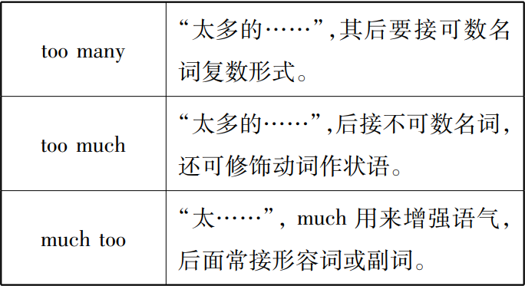
4.易混辨析：
too many, too much, much too
There are ______________ flowers in the garden.
I have ______________ homework this evening.
This little boy is ____________ fat.
too many
too much
much too

Slide 22
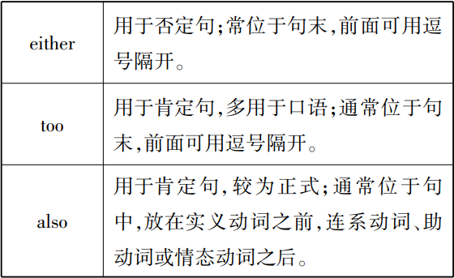
either, too, also
I play football after school, too.
= I ________ football after school.
I don’t like math. Jim doesn’t like it, _________.
Either I or my mother _______every day.
are doing the dishes B. is doing the dishes
C. wash the dishes D. washes the dishes
also play
either
D

Slide 23
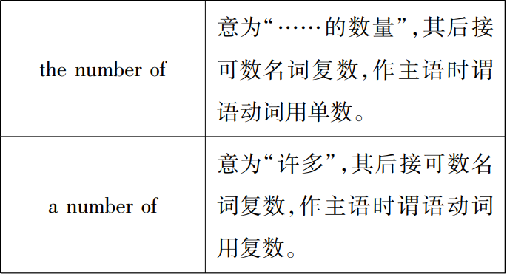
the number of , a number of
The number of the students in our school ________ ( be) 2,000.
A number of students ________ (play) on the playground now.
--Hi, Mary. The number of the books in this library _______ about 800,000, right?
--Yes. And a large number of them _______ about science and technology(科技）
is
are playing
is
are

Slide 24
other，others, the other，the others，another；
other 具有形容词性，意为：其他的，另外的；
1.other+（可数/不可数）名词
This plan doesn't work，so let's think about other plans.
Would you like other beer?
2. 1) (不定代词）修饰词+other+（可数/不可数）名词 eg：some/many+other+books一些其他的书。（不定代词）
2) Every+ other +day 每隔一天。（不定代词）
3) any other + 单数名词 any other day任何的其他日子
3.数词+other+（可数/不可数）名词 two other weeks 另外的两周
4.（物主代词）修饰词+other+（可数/不可数）名词 my other friends 我的其他朋友
5.短语 each other
As best friends，we should help each other.作为好朋友，我们应该互相帮助。

Slide 25
other，others, the other，the others，another；
others 具有名词性，意为：其他的人或物；
1.others=other+可数名词
This plan doesn't work，so let's think about other plans.
=This plan doesn't work，so let's think about others.
2.some ...others...
People go to the war, some come back alive but others don't.
人们去了战场，有的活着回来，但是其他的没有。

Slide 26
other，others, the other，the others，another；
the other特指范围内的其他
1.the other具有形容词性
1)（当对象只有两个时，the other 指另一个）
She has twin sisters，one is a teacher but the other is a nurse.
2)当对象不止两个时，the other 指剩下的全部
There were a lot of apples on the table，but now there is only one left，where are the other apples？
2.the other具有名词性
Where are the other students？=where are the others？
3.相关的短语
the other day前段时间的某天（错译：另外的一天 ） the other night前段时间的某晚
the other morning前段时间的某个早晨
They broke up the other day他们前几天分手了

Slide 27
other，others, the other，the others，another；
another 泛指另外的一个
1.another 形容词性
1）another+单数的可数名词, in another place在另外的一个地方 in another time在另外的一个时间段
in another face在另一张面孔 in another life 在另外的一种生活
another 泛指另外的一个
2.another名词性，另外的一个人或事物
A strong man can save himself. A great man can save another=another man.
注意：another 不能与a 连用如：another a few weeks（错）another few weeks（对）
题目：
1.Would you like to have____(other/another)hamburger?
(注意:another+单数名词；other+复数名词/不可数名词）
2.I have 100 books, 30 of them are novels，20 of them are about history，__________(others/the others) are about science.
3.You can‘t walk on this side of the road. You should choose ____（another/the other) side.

